Slide 1
MLP Project On Diamond prices
Pierre Kachi 232732
Rami Chalouhi 221631
Said Chebbo 220700

Slide 2
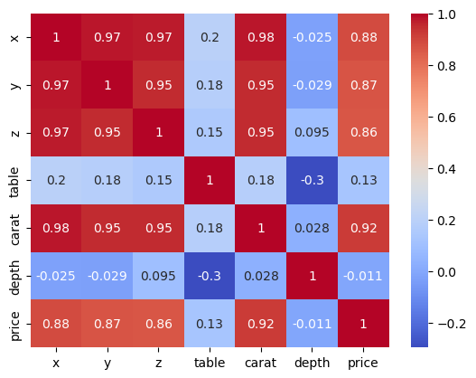
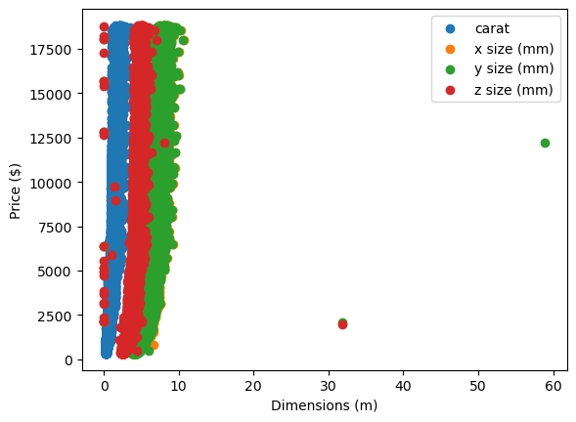
Beginning of the Project
01
Choosing the dataset
02
Visualizing Data
03
Picking the MLP features
We picked a dataset with information related to diamond prices including all their properties.
Using matplotlib and seaborn, we plotted the following heatmap and scatterplot to help us grasp the data
As can be seen on the heatmap, the only inputs with decent correlation factors to the price are the dimensions and carats

Slide 3
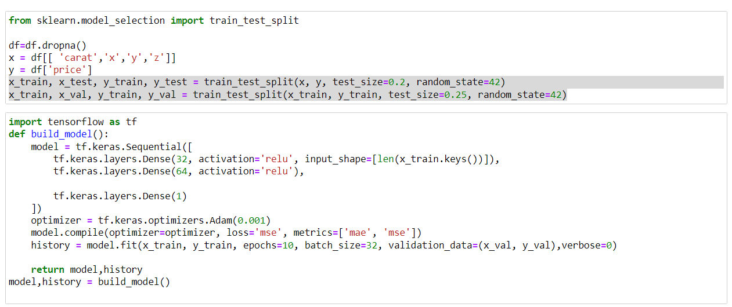
Splitting Data And Building the Model

Slide 4
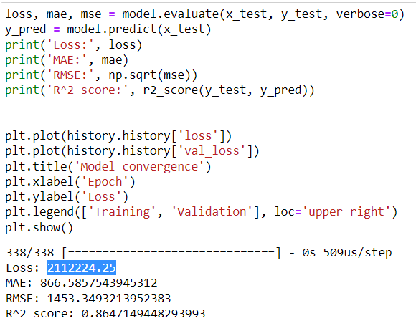
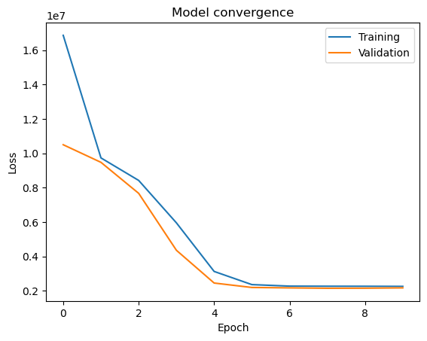
Performance Metrics and Convergence

Slide 5
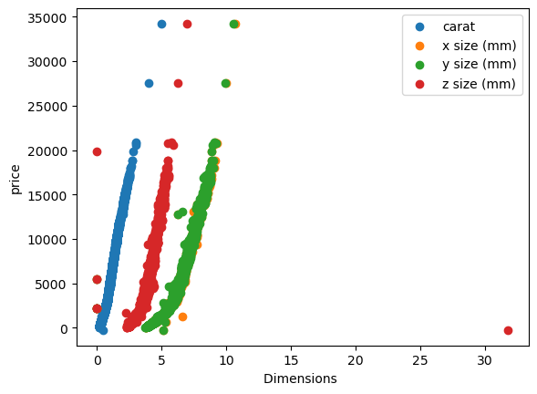
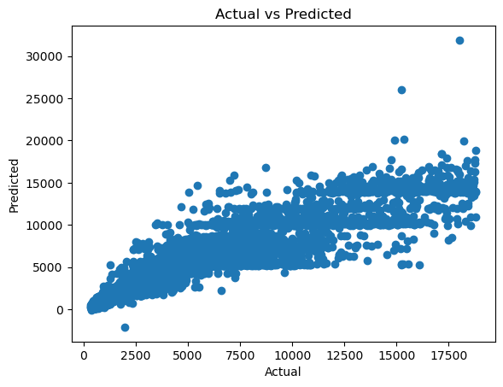
Predicted Data
We once again used the matplotlib library, this time to plot the data predicted by our model. The first one showcases the raw generated data, which we found to be relatively representative of the actual information.
The second plot compares the real and generated data. Ideally, this graph would have been a straight line, and though our results are satisfactory, we could not manage achieve any better yields.

Slide 6
Conclusion
As previously managed, though our results were not as satisfactory as we would’ve wanted, they are still pretty satisfactory, and we honestly see a multitude of ways this model could be applied in real world situations, such as trying to appraise the worth of jewelry without having to go through potentially fraudulent middlemen. We truly learned a lot through this project…
THANK YOU FOR YOUR TIME!

